Slide 1


presents
Proof of Concept and Software Demonstration
Marianne Manaog
Rob Mennell
Alberto Rossotto
Djordje Savanovic
Notes:
Hello. The Software Engineering Project Management course, November 2022, is pleased to present our project. Our group consists of Marianne Manaog, Alberto Rossotto, Djordje Savanovic, and I’m Rob Mennell.
Our toy concept is the “Chameleo Car.”
This is a smart-phone controlled toy race car capable of changing colour and customising its appearance with the goal of encouraging diversity in racing.

Slide 2
Concept Introduction
Mission
To create a toy that encourages diversity and inclusion in car racing
Vision
To increase diversity in gender, age, ethnic representation, and sexual orientation in top-tier racing leagues, such as Formula 1
Approach
Build an engaging smart phone-controlled race car that allows users to customise the driver’s appearance and car colour
Output & Current State
Software that enables desired functionalities in the toy car, and a simulation environment to test these functions
Notes:
Currently, racing leagues fail to represent the diversity of our population (Mitchell-Malm, 2021; Reid & Lightfoot, 2019; Howe, 2022).
By creating a toy that 1) appeals to all children, and 2) shows that drivers can look like anyone, we hope to grow and recruit drivers as diverse as the world around us.
What we have, today, is software that enables functionality of the car, and a simulation environment to demonstrate these functions.

Slide 3
Requirements: ‘Child’ Persona
Child
# | Requirement | Type | Priority
1 | Control race car’s movement | Functional | High
2 | Control race car’s speed | Functional | High
3 | Honk the horn | Non-functional | Low
4 | Change race car’s colour | Functional | High
5 | Customise driver’s appearance | Functional | High
6 | Display battery status | Non-functional | Medium
7 | Send alert when battery is lower than 20% | Non-functional | Low
Notes:
Before we began any design or development activities, we first generated requirements for the toy’s software.
To do so, we used a persona-based framework - a best practice in software engineering (Nielsen & Nielsen, 2019).
After considering the many potential use cases, scenarios, and relationships with this toy, we settled on three personas:
‘Child,’ the primary user of the toy, likely between 6 and 12 years of age
‘Guardian,’ the parent, caretaker, or responsible party monitoring the child’s interaction with the toy
‘Producer,’ the manufacturer of the final physical toy and distributer of the accompanying smart phone app
Unfortunately, we did not have access to child users, so we researched features of comparable toys on the market.
Thus, there is inherent risk that these requirements do not reflect user wants and needs.
Requirements are prioritized in order of 1) functional dependencies as aligned with our mission and 2) predicted user enjoyment.

Slide 4
Requirements: ‘Guardian’ & ‘Producer’ Personas
Guardian
# | Requirement | Type | Priority
1 | Password-protected parental control access | Functional | Medium
2 | Limit maximum speed in the parental control menu | Functional | Medium
3 | Set driver’s appearance as a photo | Non-functional | Low
Producer
# | Requirement | Type | Priority
1 | Receive usage-related statistics | Non-functional | Low
2 | Receive diagnostic reports | Non-functional | Medium
3 | Implement CI/CD for future software updates | Non-functional | Medium
Notes:
As with the ‘child’ persona, we did not have access to Guardian or Producer users, so we conducted additional research to identify the primary equities of these personas.
Guardian requirements ensure that the child has a safe and nurturing experience with the toy.
Producer requirements enable troubleshooting and future development.

Slide 5
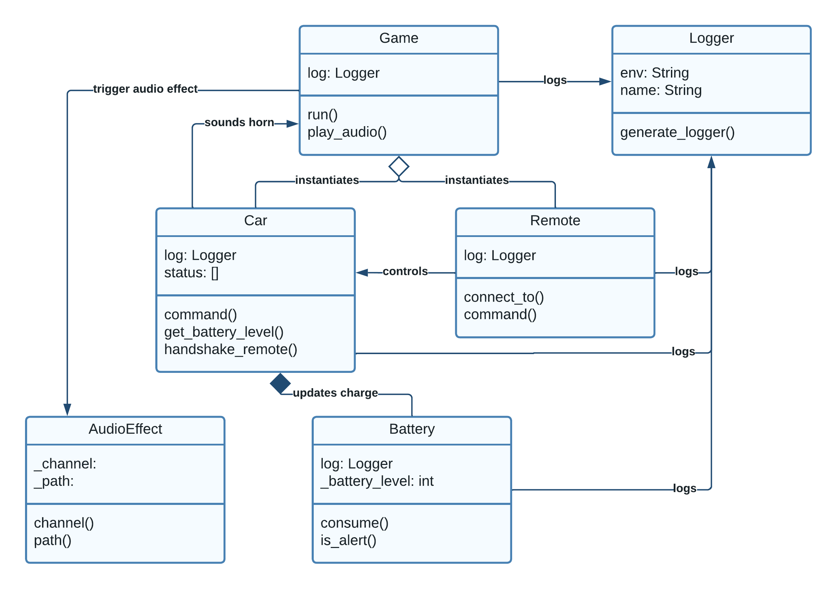
Design and Plan
Notes:
We applied object-oriented design principles in terms of classes, attributes, methods, and relationships (Phillips, 2018)
After researching similar applications, we decided to leverage common game functions from the widely-adopted pygame library (Pygame, 2022). Alexander Svilarov’s “Race It!” app inspired our vehicle control, physics, and background implementation (2019).
Alberto will expound on the design and plan.

Slide 6
Sprint Progress and Project Status
Release 1
Release 2
Sprint 1
Sprint 2
Sprint 3
Notes:
This slide shows a sprint-level view of our software development plan
Using Agile principles, we allocated requirements across three fortnightly sprints for this initial release.
Due to complications with the parental control menu, the requirements for the Parent persona were shifted to Release 2.
Our progress was enabled by mapping dependencies during the planning phase, adhering to the development plan, and properly testing code before building upon it.

Slide 7
Budgets and Summary
Labour Category |  | Hourly Rate (GBP) | Sprint 1 |  | Sprint 2 |  | Sprint 3 |  | Total Hours | Total Cost (GBP)
 |  |  | Week 1 | Week 2 | Week 3 | Week 4 | Week 5 | Week 6
Project Manager | Planned | 140.00 | 24 | 12 | 12 | 12 | 12 | 24 | 96 | 13,440.00
 | Actual | 140.00 | 25 | 11 | 10 | 10 | 13 | 22 | 91 | 12,740.00
 | Delta |  | -1 | 1 | 2 | 2 | -1 | 2 | Delta | 700.00
Developer | Planned | 130.00 | 80 | 80 | 80 | 80 | 80 | 80 | 480 | 62,400.00
 | Actual | 130.00 | 75 | 79 | 80 | 80 | 80 | 85 | 479 | 62,270.00
 | Delta |  | 5 | 1 | 0 | 0 | 0 | -5 | Delta | 130.00
Tester | Planned | 80.00 | 12 | 24 | 24 | 24 | 24 | 48 | 156 | 12,480.00
 | Actual | 80.00 | 8 | 20 | 25 | 30 | 30 | 53 | 166 | 13,280.00
 | Delta |  | 4 | 4 | -1 | -6 | -6 | -5 | Delta | (800.00)
 |  |  |  |  |  |  | Total Planned Cost: |  |  | 88,320.00
 |  |  |  |  |  |  | Total Actual Cost: |  |  | 88,290.00
 |  |  |  |  |  |  | Budget Remaining (GBP): |  |  | 30.00
 |  |  |  |  |  |  | Deviation (%): |  |  | -0.03%
Notes:
As a team of seasoned IT professionals, we used a combination of methods to estimate our labour allocation. These methods included top-down, bottom-up, and expert judgment estimation techniques (Nasir, 2006). We considered our total time and resources available, level of effort per task, and experience with similar projects (Nasir, 2006). The budget reflects standard commercial rates for custom software development.
Our team did not limit a member to a specific role, as each person contributed to multiple functions. Thus, we made an effort to track our time according to the tasks performed. Our efforts were largely on track with our initial projection.

Slide 8


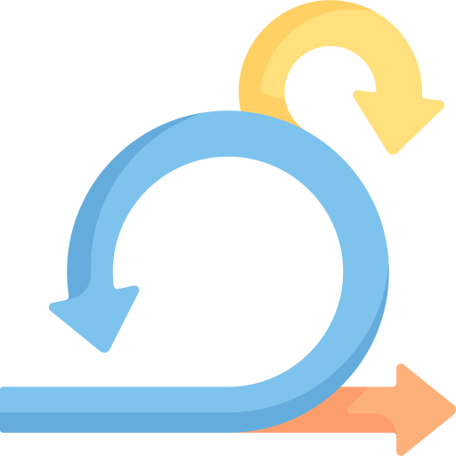
Development and Testing
Developed with Agile Scrum, using GitHub as a VCS and requirement tracker, and GitHub Actions for CI/CD
Uses pygame module for implementation, Gherkin for requirements testing, pytest for testing, bandit and safety for security checks
User acceptance testing validated each requirement for Release 1
Notes:
The team used Agile Scrum methodology for development, using GitHub as a version control system (VCS) and requirement tracker. We used GitHub Actions for CI/CD.
This software uses the pygame module for its game functions, Gherkin for requirements testing, pytest for testing, as well as bandit and safety for security checks
Marianne will elaborate upon testing throughout the development lifecycle.
Djordje will walk us through some of the user acceptance tests.

Slide 9
Challenges and Solutions
Challenge | Solution
Geographically and temporally disbursed development team | Weekly progress meetings and continuous collaboration over Slack, GitHub
Development in different environments | Modular Python package-like structure and a common environment.yml
Complex codebase for linting and quality control | Enabled linting through GitHub Actions
Notes:
Though there were many difficulties along the way, we had three primary challenges to overcome.
Having a geographically disbursed team, with six hours of time difference, required flexible and persistent communication. Slack and GitHub integrated our efforts.
Developing software remotely, using different operating systems and environments, required additional testing and setup configuration. We implemented a modular structure and a common environment.yml file which standardised setup and minimised the room for configuration errors.
Initially, linting checks were run manually, but automating them via GitHub Actions enabled early visibility and correction of errors to increase code quality.

Slide 10
References
Gaikwad, V., Joeg, P., & Joshi, S. (2017) AgileRE: Agile requirements management tool. In Proceedings of the Computational Methods in Systems and Software (pp. 236-249). Springer, Cham.
Howe, O. R. (2022) Hitting the barriers–Women in Formula 1 and W series racing. European Journal of Women's Studies 13505068221094204.
Klotins, E., Gorschek, T., Sundelin, K., & Falk, E. (2022) Towards cost-benefit evaluation for continuous software engineering activities. Empirical Software Engineering 27(6): 157.
Kreitz, M. (2019) Security by design in software engineering. ACM SIGSOFT Software Engineering Notes 44(3): 23-23.
Mitchell-Malm, Scott (2021) “Hamilton Commission Reveals Stark F1 Diversity Findings”. The Race.com. Available from: https://the-race.com/formula-1/hamilton-commission-reveals-stark-f1-diversity-findings/.) [Accessed 22 Jan. 2023].
Nasir, M. (2006). A Survey of Software Estimation Techniques and Project Planning Practices. [online] IEEE Xplore. doi:10.1109/SNPD-SAWN.2006.11.‌
Nielsen, L., & Nielsen, L. (2019) Making Your Personas Live. Personas-User Focused Design 161-170.
Phillips, D. (2018). Python 3 Object-Oriented Programming. 3rd Edition. [Insert Publisher Location]: Packt Publishing.
Pygame. (2022). [online] Available at: https://www.pygame.org/.
Reid, M. B., & Lightfoot, J. T. (2019) The physiology of auto racing: a brief review. Medicine and science in sports and exercise 1-15.
Svilarov, A. (2019). Race It! - 2D Racing Game. Available from: https://appoftheday.downloadastro.com/app/race-it-2d-racing-game/ [Accessed 12 Jan. 2023].
Xie, T., Tillmann, N., & Lakshman, P. (2016) Advances in unit testing: theory and practice. In Proceedings of the 38th international conference on software engineering companion, 904-905.
Notes:
A variety of sources, listed here, helped us with during this assignment.
This concludes our presentation. We appreciate the opportunity to brief our project and thank you for the constructive feedback throughout this course.

